Slide 1


5th DOCTORAL SYMPOSIUM ON COMPUTATIONAL INTELLIGENCE
(DoSCI-2024)
10 May 2024.
Beyond Likes and Reps: A Deep Dive into the Evolution of Fitness Communities through a Customizable Social Media Platform
Pawan kumar*, Sanskriti Rana, Gagan Thakral
Department of computer science & Engineering
KIET Groups of Institutions, Delhi-NCR, Ghaziabad, 201206

Slide 2
INDEX
Abstract
Introduction
Literature Review
Research Gaps
Proposed Methodology
Result & Discussion
Comparative analysis
Conclusion & future work
References

Slide 3
2. ABSTRACT: This research paper delves into how evolving social media platforms shape the healthcare community. Using a mixed-methods approach, it analyzes qualitative user narratives alongside quantitative collaborative metrics. The study examines how users curate healthy content, connect with peers, and contribute to online social networks. It aims to understand the impact of these changes on user experience, motivation, and public health. While social media fosters a global fitness community with motivational content and connections, it also presents challenges like unrealistic standards and misinformation. The paper concludes that while social media offers a potent tool for positive change, users must navigate it wisely to harness its benefits fully.
Keywords: Platforms, Community, Public health, User experirnce

Slide 4
3. INTRODUCTION:
Our fitness social media platform offers personalized workout routines, nutritional guidance, and a supportive community, empowering users to align fitness with their unique goals . With a vibrant virtual community, users share experiences and insights, fostering mutual support .
Despite increasing global obesity rates, 61.4% of the population are social media users, with fitness content being highly popular . However, 17.7% show high risk for eating disorders, highlighting the platform's need to address mental well-being .
The platform also promotes a safe, online space free from body-related risks . Join us to redefine fitness as a personalized, community-driven journey that prioritizes both physical and mental health.

Slide 5
4. LITERATURE REVIEW :
Suyin Jiang et al. (2017) Regular physical activity is essential to maintain health and well-being at all stages of life. It is emphasized that lack of exercise can lead to many health problems and the importance of physical support.
Hyung-Min Kim (2022) This study, rooted in social comparison theory, explores how fitness app users' upward comparison boosts self-efficacy, motivation, and participation in physical activities.
Victoria A. Goodyear et al. (2021) This systematic review aimed to update evidence on social media interventions for physical activity and diet post-2014, analyzing effective intervention characteristics and assessing outcomes
Rebecca A. Glazier et al. (2021) Community-based research benefits from social media as a recruitment and communication tool. A study in Little Rock found increased participation and result distribution.
Therese Fostervold Mathisen et al. (2021) [16] This study demonstrates the prevalence of sexual violence among health teachers by investigating gender differences and roles. Based on the perspective of the four theories and previous studies.
Jong, S. T. et al (2020) [12] This article explores the effects of online exercise from a pedagogical perspective, focusing on health and wellness information posted on social networking sites (SNS).
Ralf Wagner et al. (2023) [15] This study explores the advantages and disadvantages of the minimal self in creating a body image by delving into the modern understanding of the ideal of body and mind.

Slide 6
5. RESEARCH GAPS :
Research on fitness social media platforms highlights both their potential and existing gaps. While these platforms emphasize personalized fitness regimens and community support, there's limited understanding of their long-term effectiveness in promoting sustained behavior change. The impact on users' mental health, particularly concerning body image and eating disorders, remains underexplored .
Moreover, studies assessing the platform's role in fostering a supportive environment to mitigate online bullying and body shaming are scarce. The platforms' inclusivity in catering to diverse populations and dietary needs is another area requiring attention to ensure equitable access and representation. Additionally, research on how these platforms adapt to user needs over time, especially as fitness goals evolve, can provide valuable insights.
Furthermore, exploring the effectiveness of engagement strategies, like challenges or live events, in maintaining user interest and participation could enhance platform design and user experience. Addressing these gaps can contribute to a more comprehensive understanding of fitness social media's role in promoting holistic well-being.

Slide 7
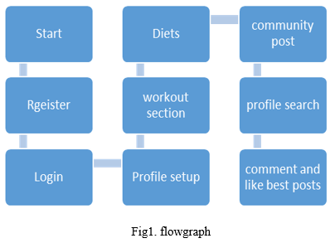
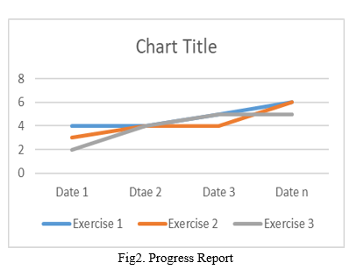
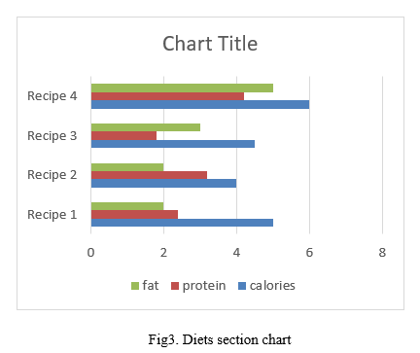
6. PROPOSED METHODOLOGY : The backend employs modular components like methods, controllers, and models for a scalable and clear codebase. It integrates machine learning algorithms, utilizing OpenCV to analyze user hand gestures through motion capture. These algorithms offer real-time posture feedback, enhancing user guidance for optimal health. Configuration files now support machine learning integration for advanced motion analysis.

Slide 8
7. RESULTS & DISCUSSION:
Fitness platforms offer stress relief through community support and interactive features. They foster a safe online space, reducing anxiety and promoting focus on exercise . Integrated photo search engines provide visual feedback, aiding informed fitness decisions and preventing musculoskeletal issues.
The platform educates users on health, nutrition, and mindful eating, supporting those with eating disorders. Additionally, it aids in combating smoking and alcohol addiction by promoting positive behavioral changes and offering social support, enhancing holistic health and self-confidence .

Slide 9
8. COMPARATIVE ANALYSIS:
Fitness platforms serve as stress-relief tools by promoting community support and interactivity. They create a safe online environment, reducing anxiety and focusing on exercise . Integrated photo search engines offer visual feedback, aiding informed fitness choices and preventing musculoskeletal issues. The platform educates on health and nutrition, supporting those with eating disorders. It also combats addiction by encouraging positive behaviors and providing social support.
In contrast, traditional fitness methods lack the interactive and educational components of digital platforms. They may not offer the same level of community support or address mental health and addiction issues directly. Digital platforms thus offer a more holistic and supportive approach to fitness and well-being.

Slide 10
9. CONCLUSION & FUTURE WORK :.
By combining the opinions of experienced fitness trainers, we cover a variety of exercises that are more than just exercise but offer customized solutions with unique results designed for the body. It's not just quantity that matters, it's quality; Understand its impact on muscles, endurance, and overall health.
Nutrition is equally important in every exercise, follow the individual. Recognizing that one size does not fit all, we are committed to providing users with meal plans that fit their specific needs and goals. This not only increases the effectiveness of your exercise but also supports a healthy and effective diet. The community is created with clear guidelines and is not just a social space; This is a social place.. Additionally, the user-friendly presentation of the information makes it accessible to users at all levels.
By simplifying fitness concepts and providing clear guidance, we demystify the world of exercise and nutrition, making health and fitness a goal for everyone. As we move forward, a commitment to continuous improvement forms the basis of our project. We will actively seek and use user feedback to ensure that the application adapts to the needs and wishes of our different users. This project is more than an application; It is a revolutionary platform that supports the health of society not only as a goal but as a way of life. Through this research, we contribute to health reform and health technology that is expected to have a long-term impact on the health of people around the world.

Slide 11
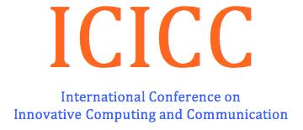
10. REFERENCES :
Scheiber R, Diehl S, Karasin M. Socio-cultural power of social media on orthorexia nervosa. Appetite. 2023 Jun 1; 185:106522. Doi: 10.1016/j.appet.2023.106522. PeHUB 2023 Mar 8. PMID: 36893917.
Kim M. How can I Be as attractive as a Fitness YouTuber in the era of COVID-19? The impact of digital attributes on flow experience, satisfaction, and behavioral intention. . 2022 Jan 1; 64:102778.
Huang, G., Sun, M., & Jiang, L. C. (2022). Core social network size is associated with physical activity participation for fitness app users: Computers in Human Behavior, 129, 107169.
Wolfers, L.N. and Utz, S., 2022. Social media use, stress, and coping. Current Opinion in Psychology, 45, p.101305.
Zhang Xu Eying. "Keeping up appearances: Testing a moderated mediation path of self-presentation motives, self-efficacy beliefs, social sharing of fitness records and fitness app uses 41.3 (2022): 644-654.
Kercher, Vanessa M., et al. "2022 Fitness Trends from around the Globe." ACSM's Health & Fitness Journal 26.1 (2022): 21-37.
Jiang S, Ning CF. Interactive communication in the process of physical education is social media contributing to the improvement of physical training performance.
Hyung-Min Kim. 2022. Social comparison of fitness social media postings by fitness app users. Computer. Hum. Bhav. 131, C (Jun 2022).
Glazier RA, Topping MP. Using social media to Advance Community-Based Research. PS: Political Science & Politics. 2021;54(2):254-258. doi:10.1017/S1049096520001705.
Jong, S. T., & Drummond, M. J. (2020). Exploring online fitness culture and young females. In Re-thinking Leisure in a Digital Age (pp. 50-62). Routledge..
Jozani, M., Ayaburi, E., Ko, M., & Choo, K. K. R. (2020). Privacy concerns and benefits of engagement with social media-enabled apps: A privacy calculus perspective. Computers in Human Behavior, 107, 106260.
Wagner R, Singh S. Consumers' body image expressions: Reflection of a Snow White or an Evil Queen. . 2023 Mar 17;14:1097740. doi: 10.3389/fpsyg.2023.1097740. PMID: 37008841; PMCID: PMC10064093.
Mathisen TF, Sølvberg N, Sundgot-Borgen C, Sundgot-Borgen J. Sexual Harassment in Fitness Instructors: 2021 Oct 29;12:735015. doi: 10.3389/fpsyt.2021.735015. PMID: 34777046; PMCID: PMC8585760.
Naslund, J. A., Bondre, A., Torous, J., & Aschbrenner, K. A. (2020). Social media and mental health: benefits, risks, and opportunities for research and practice. Journal of technology in behavioral science, 5, 245-257
Wilksch, S. M., O'Shea, A., Ho, P., Byrne, S., & Wade, T. D. (2020). The relationship between social media use and disordered eating in young adolescents. International Journal of Eating Disorders, 53(1), 96-106.
Grover, P., Kar, A. K., & Dwivedi, Y. K. (2022). Understanding artificial intelligence adoption in operations management: insights from the review of academic literature and social media discussions. Annals of Operations Research, 308(1-2), 177-213.

